Slide 1
Trajectory K means: Finding similar temporal patterns of sEEG activity simultaneously across dimensions
Tal Seidel Malkinson & Jacobo Sitt

Slide 2
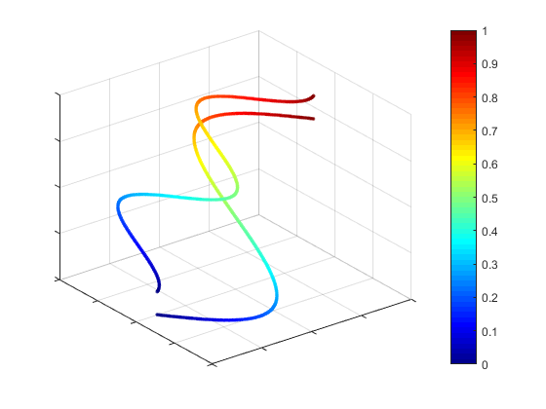
Objective
Trajectories
To develop a non-supervised method to identify the main types of dynamical trajectories a system expresses.
3 important variables:
The observations: what do we want to cluster?
sensors / trials
The features: the dimensions that define the space in which the trajectory is expressed.
Time
Z
Time
Y
X

Slide 3
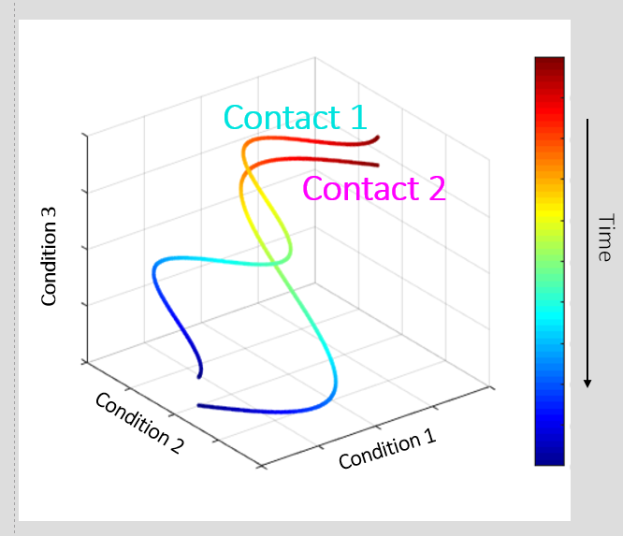
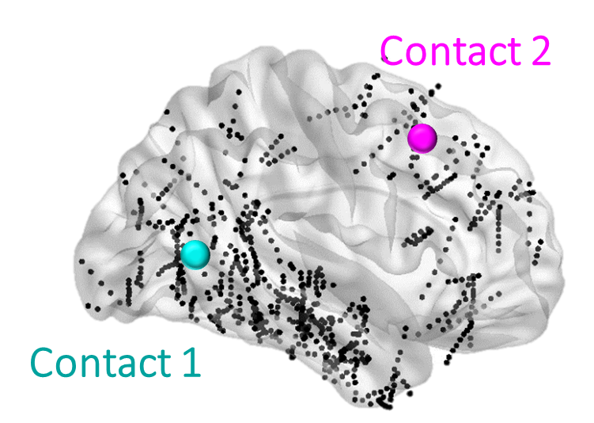
Two uses in typical neuroscience datasets
1. Sensor clustering
Can we identify clusters of sensors with similar temporal profile across all exp conditions?
The observations: The sensors (e.g, M/EEG/iEEG sensors, brain regions, voxels etc..)
The features: Experimental conditions

Slide 4
Two uses in typical neuroscience datasets
2. Trials clustering
Can we identify clusters of trials with similar temporal profile (consciously perceived VS non perceived)?
The observations: The trials
The features: The sensors
trial 1
trial 2
Z
Contact 3
Time
Y
Contact 2
X
Contact 1
Note: Frequently the numbers of dimensions (sensors) must be reduced, typically using PCA or other whitening mechanisms.

Slide 5
The algorithm
Based on k-means clustering
The number of output clusters (k) is a given parameter
The main adaptation is the way we measure distance:
To quantify how similar the trajectories are (while preserving time) distance is measured as the sum of the L1 distance, time point by time point.
Example (2 trajectories in 2 dimensions, 5 time points)
Trajectory 1: ([0,0], [1,0], [2,0], [2,-1],[1,-2])
Trajectory 2: ([0,0], [0,1], [1,1], [2,1], [2,2])
Distance = 0 + 2 + 2 + 2 + 5 = 11

Slide 6
Toy examples (in two dimensions)

Slide 7
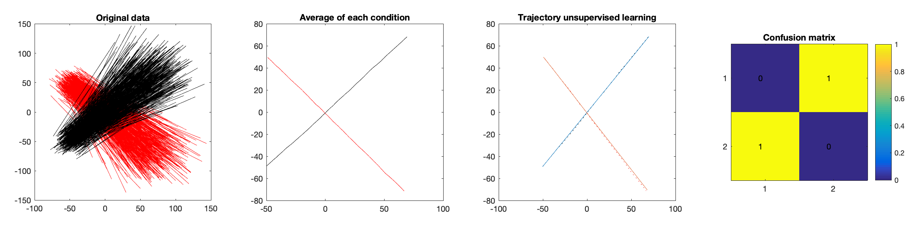
Example 1: Two clusters with different starting and ending points
(A)
(B)
(C)
(D)
(A) All the trajectories in the phase space (black, group 1; red, group 2), each axis corresponds to one dimension. (B) Average of all group 1 and 2 observations. (C) Centers of the unsupervised obtained clusters (solid line cluster center, dashed ground truth with known labels). (D) Confusion matrix, in this case the algorithm correctly identifies all observations.

Slide 8
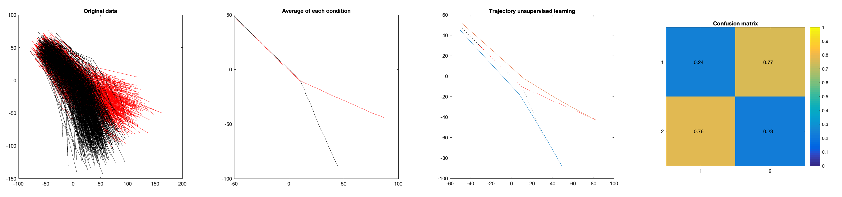
Example 2: Two clusters with identical starting points, share half of the trajectory but then diverge
(A)
(B)
(C)
(D)
(A) All the trajectories in the phase space (black, group 1; red, group 2), each axis corresponds to one dimension. (B) Average of all group 1 and 2 observations. (C) Centers of the unsupervised obtained clusters (solid line cluster center, dashed ground truth with known labels). (D) Confusion matrix, in this case the algorithm correctly identifies ~75% of observations.

Slide 9
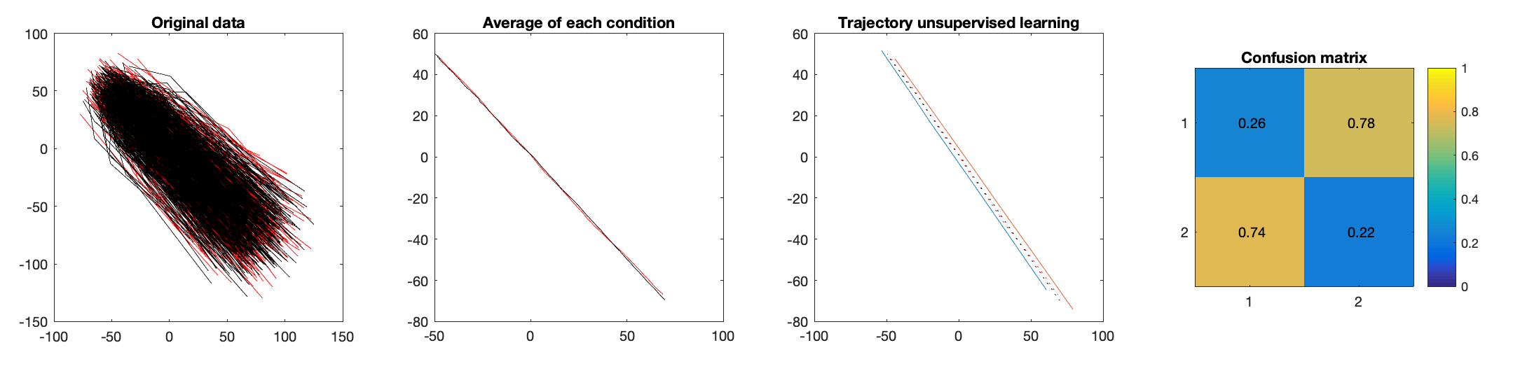
Example 2: Two clusters with identical starting and ending points, but in one group speed is double in the first half of the trajectory and vice-versa
(A)
(B)
(C)
(D)
(A) All the trajectories in the phase space (black, group 1; red, group 2), each axis corresponds to one dimension. (B) Average of all group 1 and 2 observations. (C) Centers of the unsupervised obtained clusters (solid line cluster center, dashed ground truth with known labels). (D) Confusion matrix, in this case the algorithm correctly identifies ~75% of observations.

Slide 10
Experimental example 1 Clustering intracranial electrodes using their trajectory in 8 exp conditions space
Seidel Malkinson et al. bioRxiv, 2022

Slide 11
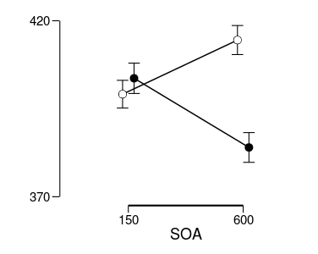
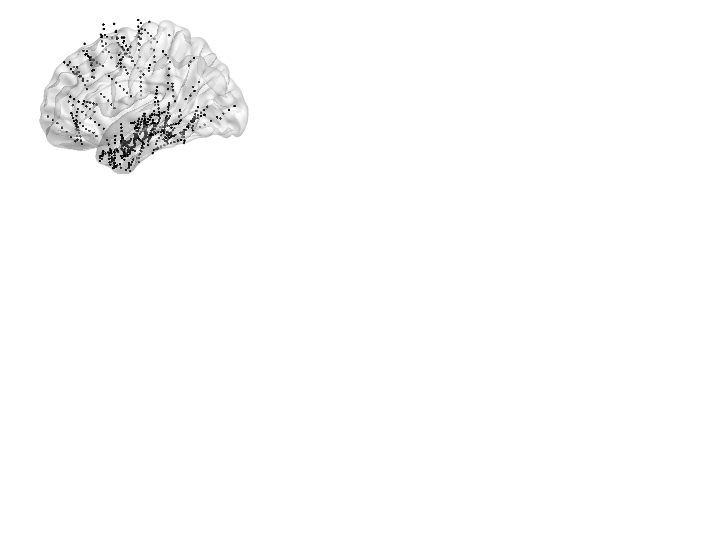
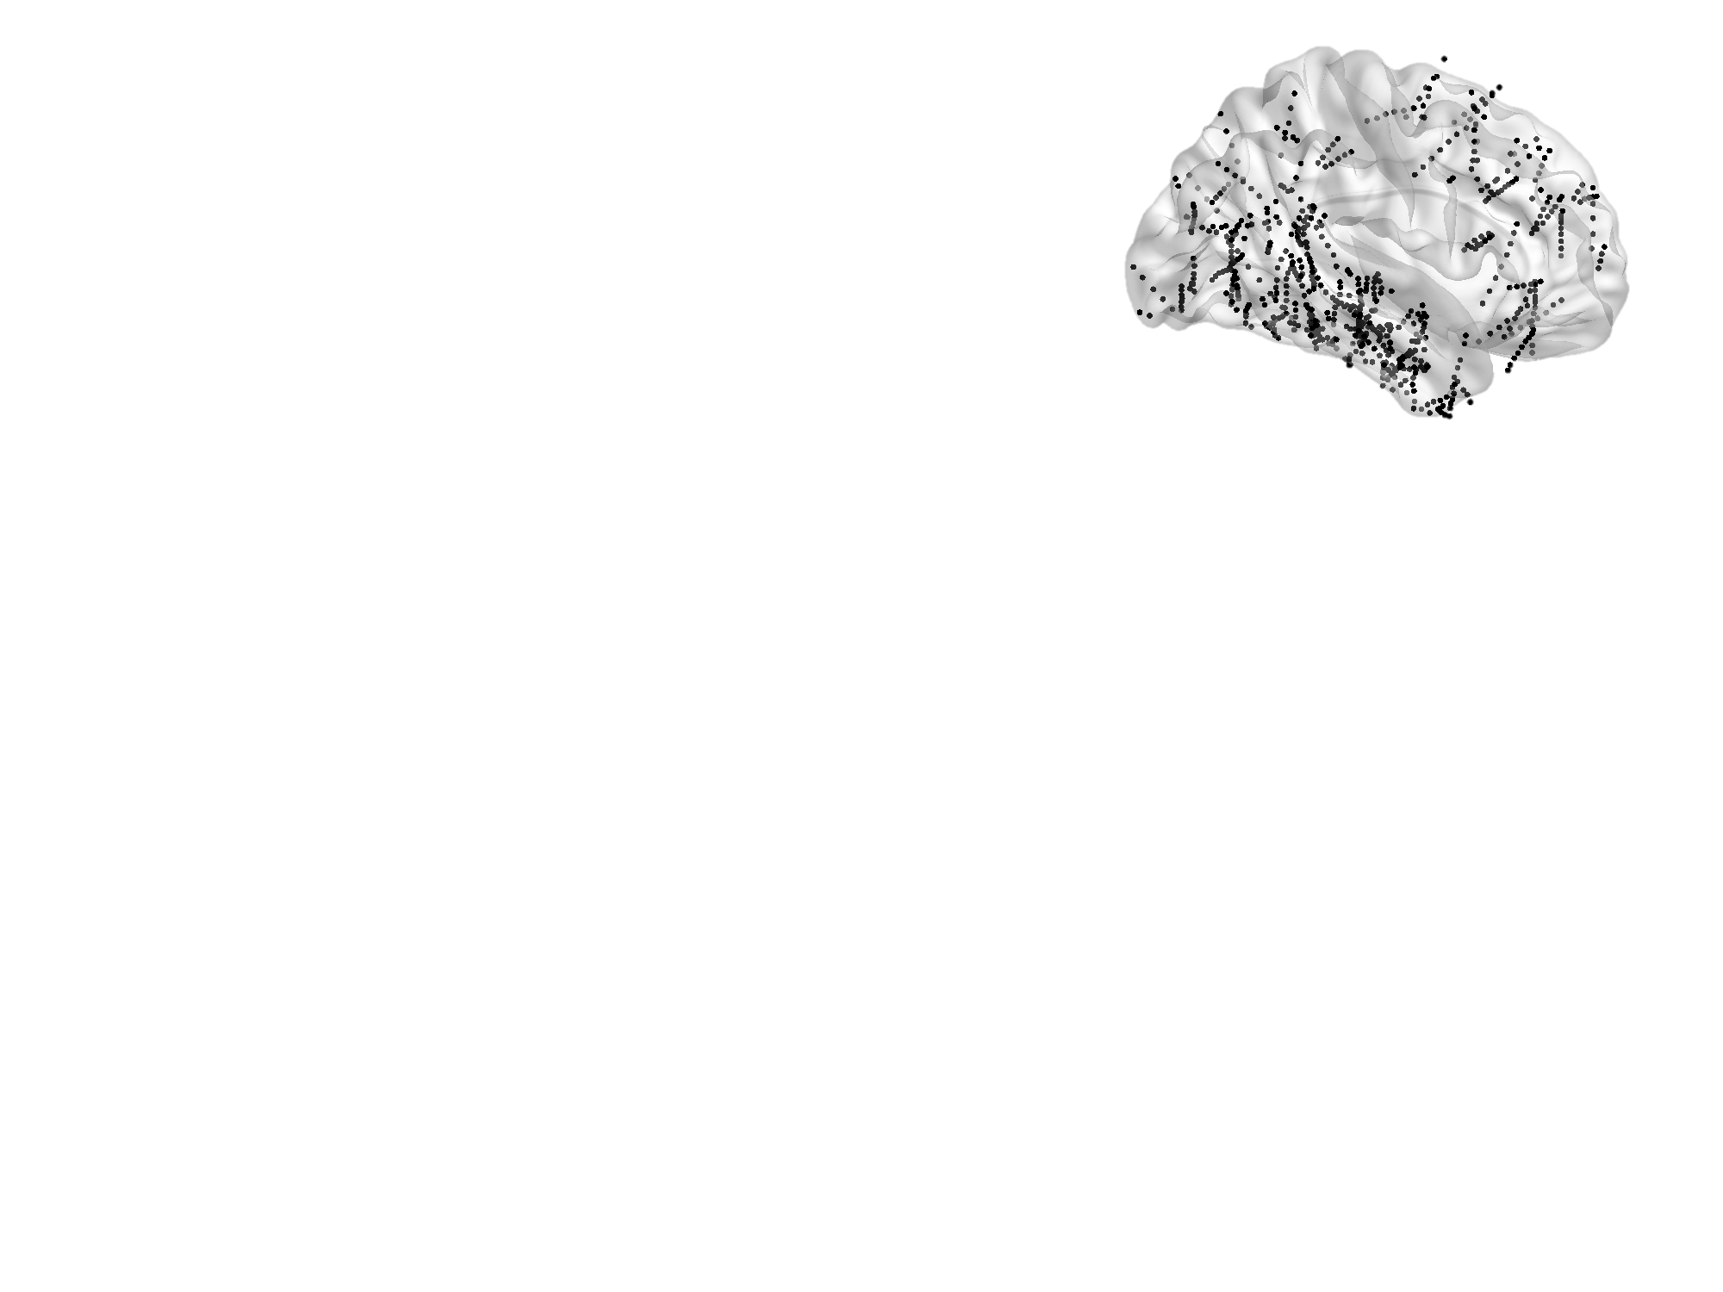
The Posner detection paradigm
Behavioral results
Congruent
Incongruent
Press the button as fast as possible when the target appears
N=28
Cue
RT [ms]
SOA (150 or 600 ms)
Congruent
Incongruent
time
[ms]
Target
SOA * Validity: p<0.001, η² = 0.595
Validity: p=0.004, η² = 0.263
Eight conditions (2X2X2)
Congruent / Incongruent
Short SOA / Long SOA
Target Ipsilateral / Target Contralateral to electrode
1403 Usable electrodes
671 in LH
732 in RH
For each electrode we compute the average across trials of the high frequency broadband power (50-155 Hz)
644 electrodes responsive for minimum 100ms in at least one condition

Slide 12
6 clusters of electrodes with similar target-locked response profile across the 8 conditions
93 electrodes
97 electrodes
67 electrodes
60 electrodes
259 electrodes
68 electrodes
Ipsilateral
Short SOA
Congruent
Contralateral
Ipsilateral
Long SOA
Contralateral
Ipsilateral
Incongruent
Short SOA
Contralateral
Ipsilateral
Long SOA
HFBB amplitude [z]
3
2
1
0
-1
Contralateral
-0.9 0 1.4
Time from target onset [sec]

Slide 13
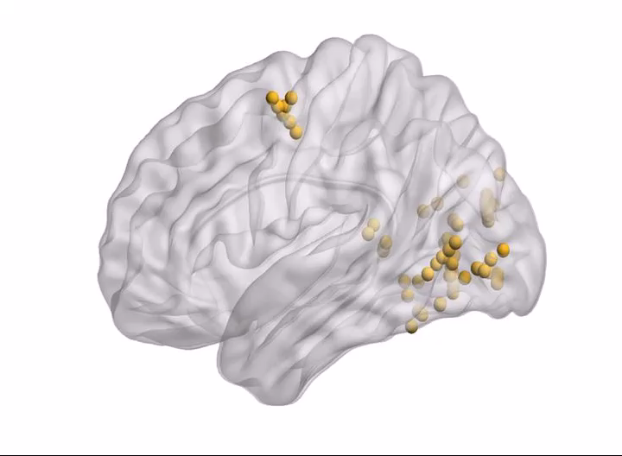
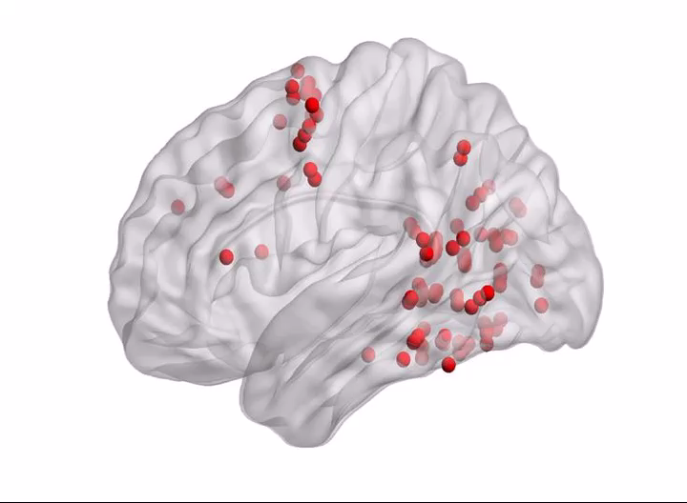
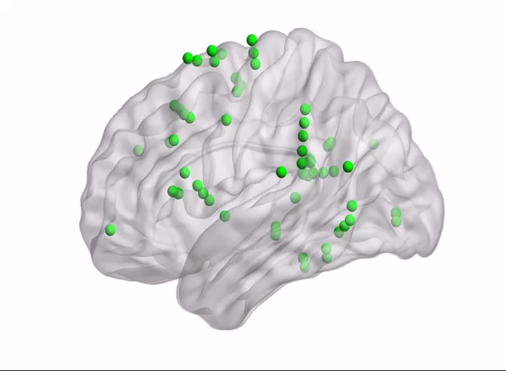
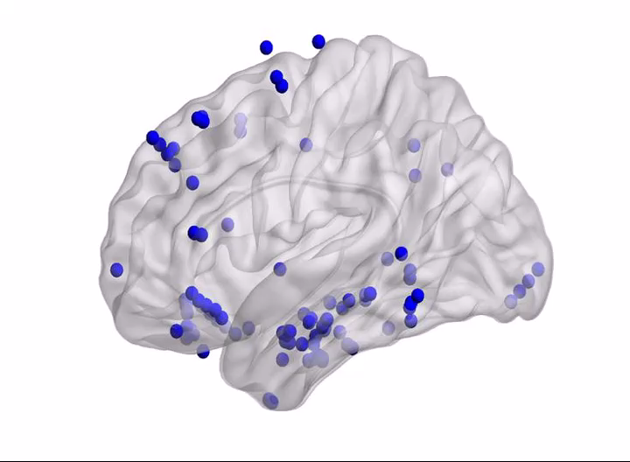
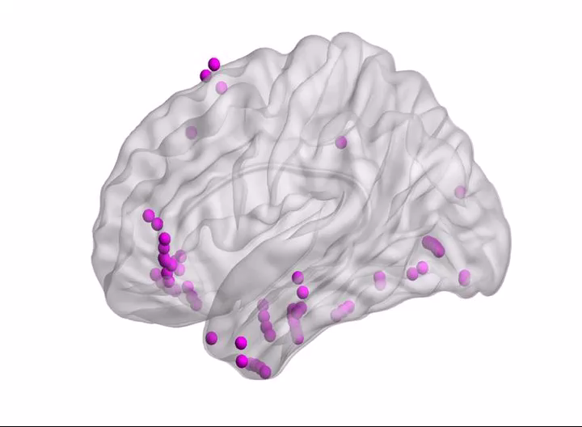
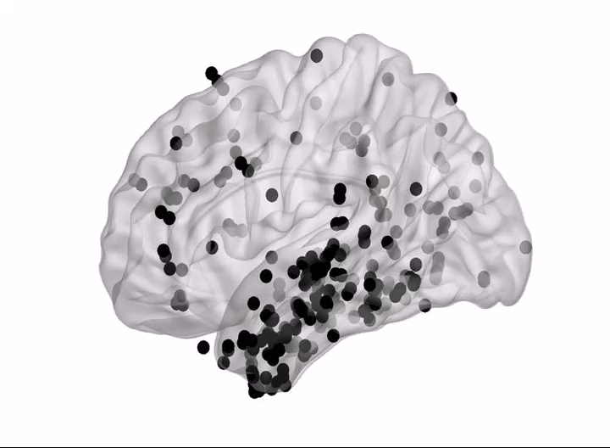
Cluster 1
Cluster 2
Cluster 3
L
R
L
R
L
R
Ipsilateral Target
Contralateral Target
Ipsilateral Target
Contralateral Target
Congruent
Congruent
Short SOA
Long SOA
HFBB power [z]
3
Incongruent
Incongruent
2
1
0
-1
1.4
-0.9
0
Time from target onset [sec]
L
R
L
R
L
R
Late suppression cluster
Late activation cluster
Non responsive cluster
Notes:
The yellow visual cluster was located in occipital regions & around FEF.
The red & green clusters, located in the posterior temporal & frontoparietal networks, the same regions previously associated with attention, and divided the TPJ between them into a caudal and rostral partition.

Slide 14
Experimental example 2
IntraSound project
Preliminary results: trajectory k-means clustering
D Rimsky-Robert, T Seidel Malkinson, J Sitt, …, C Sergent

Slide 15

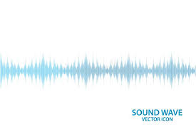
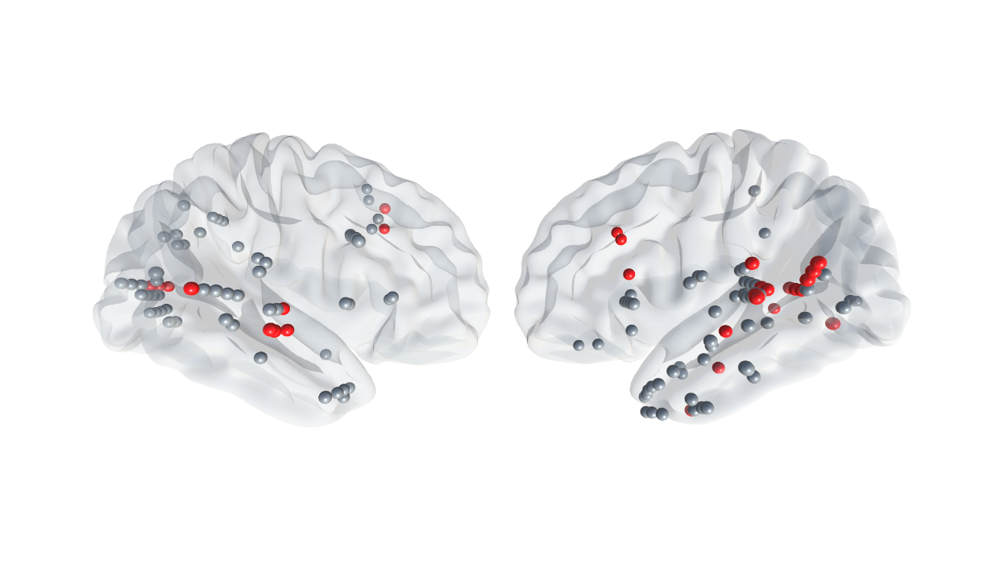


Clustering intracranial electrodes according to the activity across different noise levels
E
A
Noise
Cluster 1
E
HFBB amplitude [z]
Audibility
13 sEEG patients

Slide 16
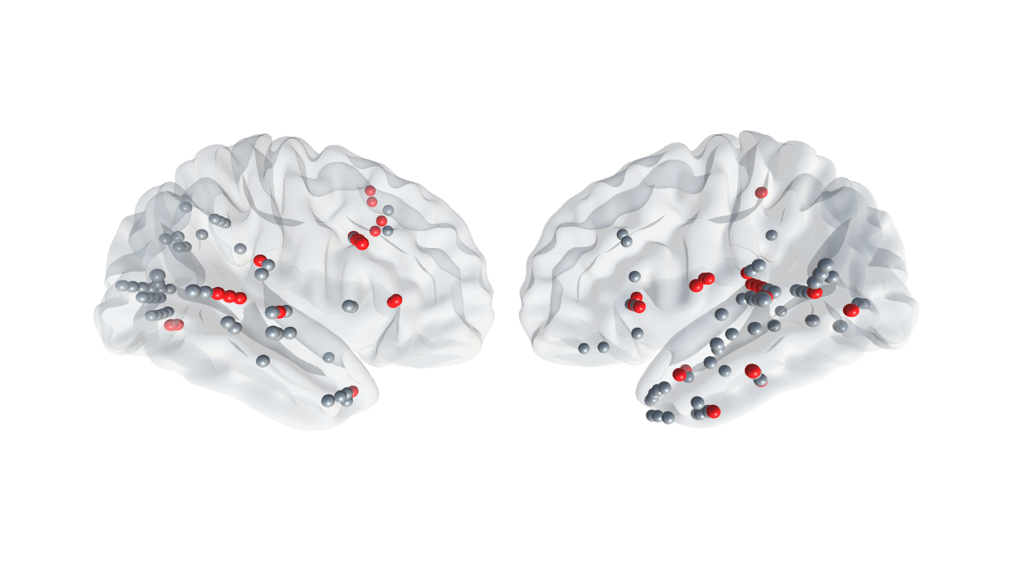
Clustering intracranial electrodes according to the activity across different noise levels
E
A
Noise
Cluster 2
E
HFBB amplitude [z]
Audibility
13 sEEG patients

Slide 17
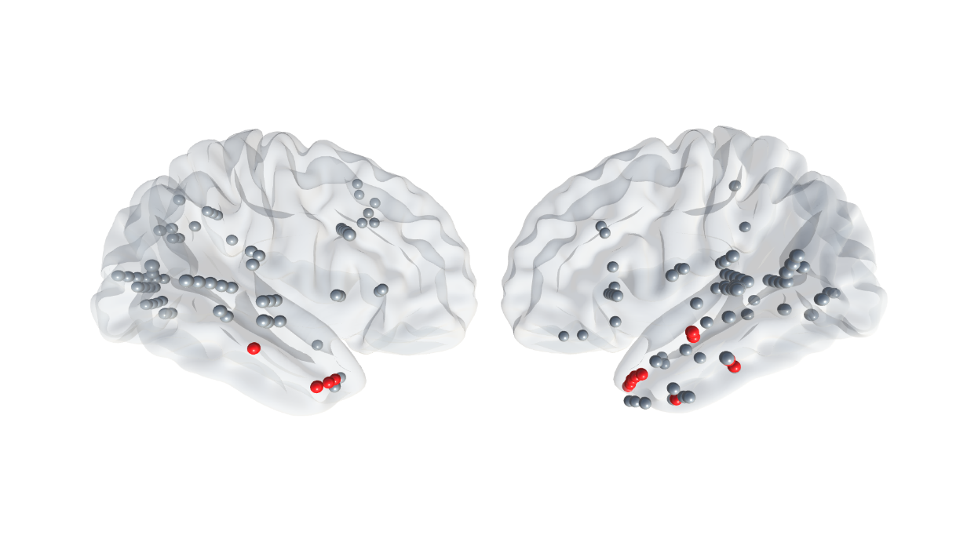
Clustering intracranial electrodes according to the activity across different noise levels
E
A
Noise
Cluster 3
E
HFBB amplitude [z]
Audibility
13 sEEG patients

Slide 18
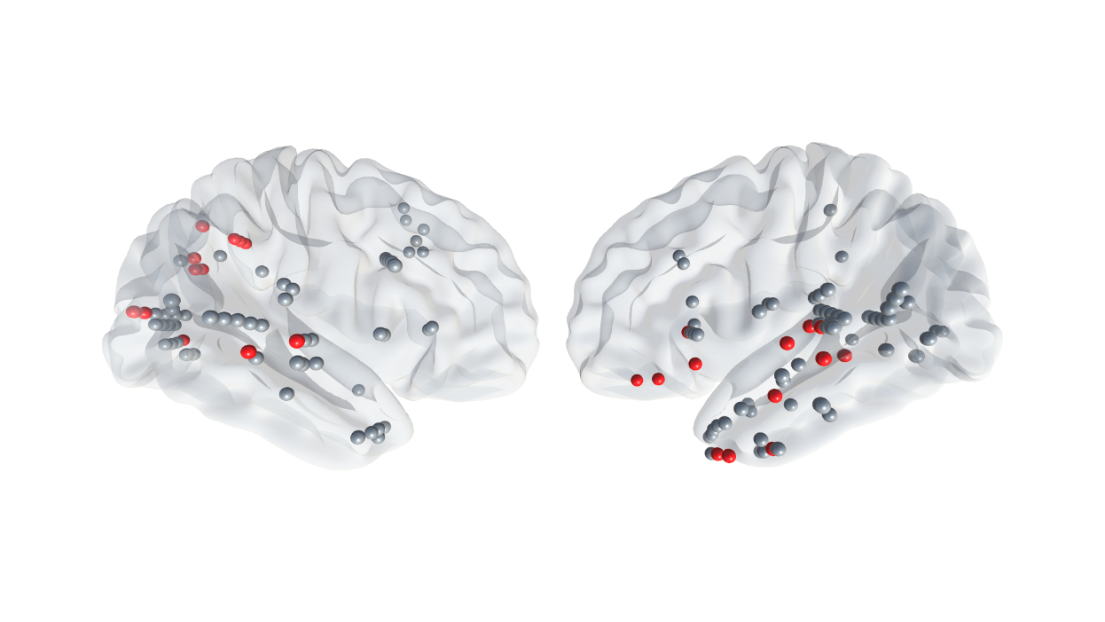
Clustering intracranial electrodes according to the activity across different noise levels
E
A
Noise
Cluster 4
E
HFBB amplitude [z]
Audibility
13 sEEG patients

Slide 19
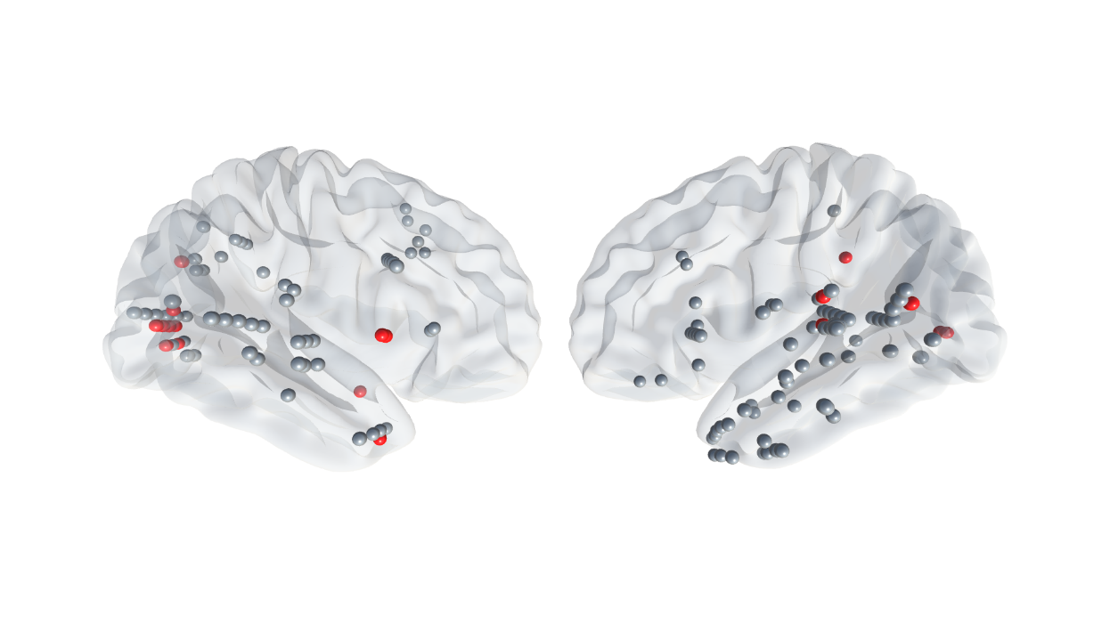
Clustering intracranial electrodes according to the activity across different noise levels
E
A
Noise
Cluster 5
E
HFBB amplitude [z]
Audibility
13 sEEG patients

Slide 20
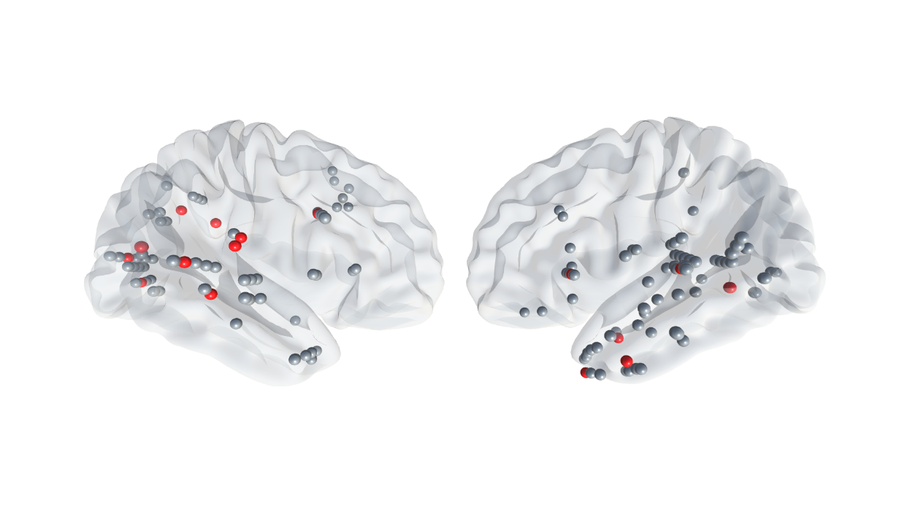
Clustering intracranial electrodes according to the activity across different noise levels
E
A
Noise
Cluster 6
E
HFBB amplitude [z]
Audibility
13 sEEG patients

Slide 21
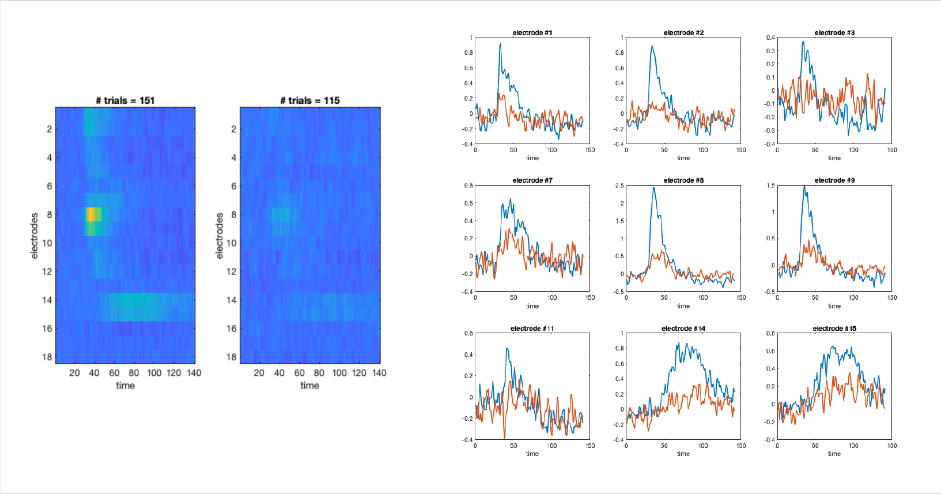
Clustering trials across intracerebral electrodes
Cluster 1
Cluster 2
E
A
Noise
E
Audibility
1 sEEG patient

Slide 22
Experimental example 3
IntraSound project:
SoundConscious (EEG, healthy participants)
Sergent et al., Nat Comm, 2021

Slide 23
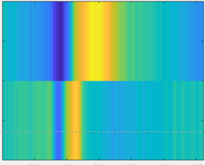
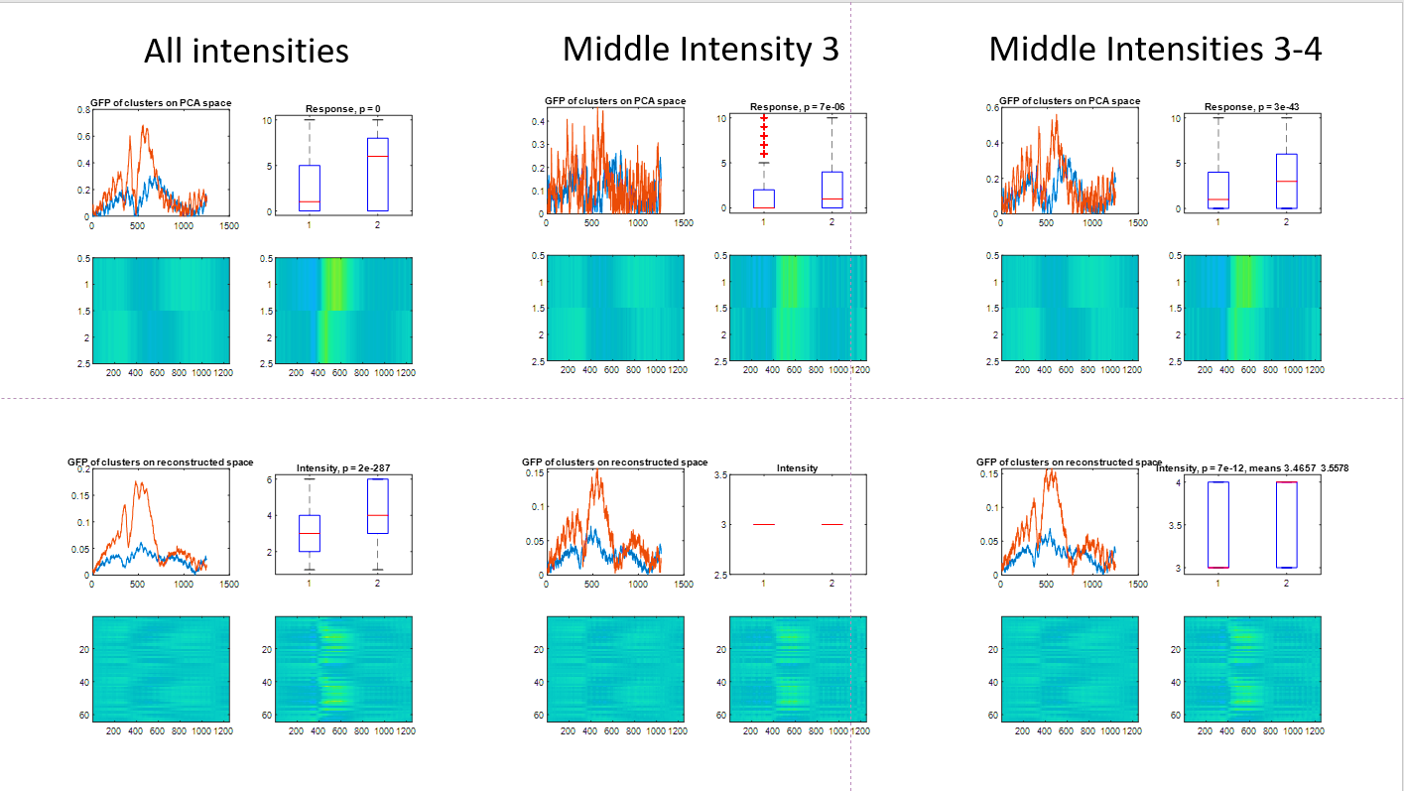
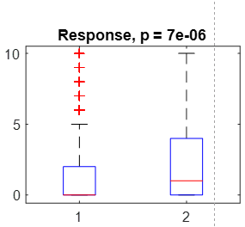

Clustering consciously perceived & non-perceived EEG trials across sensors, pooled participants’ single-trials
E
A
Cluster in PCA space all noise levels
Noise
1
Global field power
E
2
Subjective audibility report
Time [ms]
Time [ms]
S1 Single trials
Test in sensors space on middle noise level
S2 Single trials
Subjective audibility report
Global field power
S20 Single trials
Trajectory k-means
Cluster
Time [ms]
Sergent et al., Nat Comm, 2021

Slide 24
Experimental example 4 Clustering flies according to their walking path

Slide 25
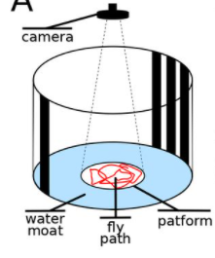

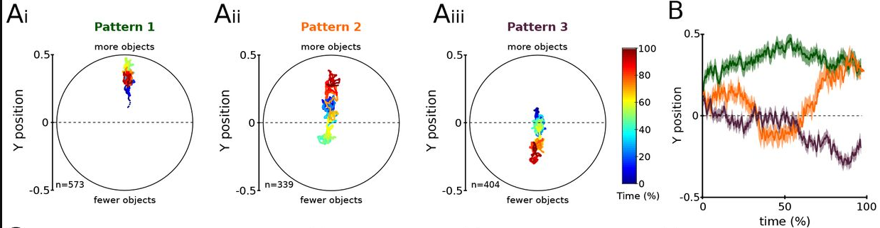
Identify flies that prefer large quantities over smaller ones
Bengochea et al., 2022

Slide 26
Future directions
Iván Mindlin
Cluster contacts across different frequency bands
Application to 7T fMRI data: cluster voxels across different exp conditions (e.g. visual categories in the ventral stream)
Build a matlab & python open code tools

Slide 27
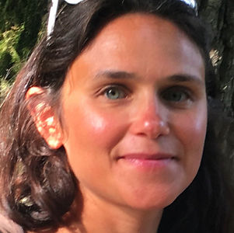
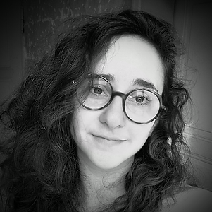

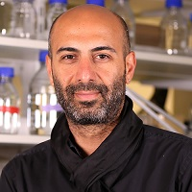
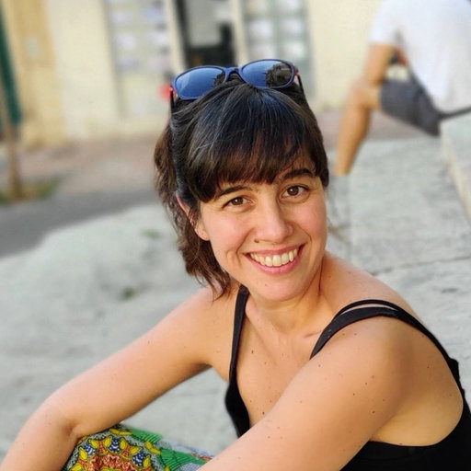
Thank you
Jacobo Sitt
Claire Sergent
Daphné Rimsky-Robert
Bassem Hassan
Mercedes Bengochea
tal.seidel@mail.huji.ac.il

